Slide 1
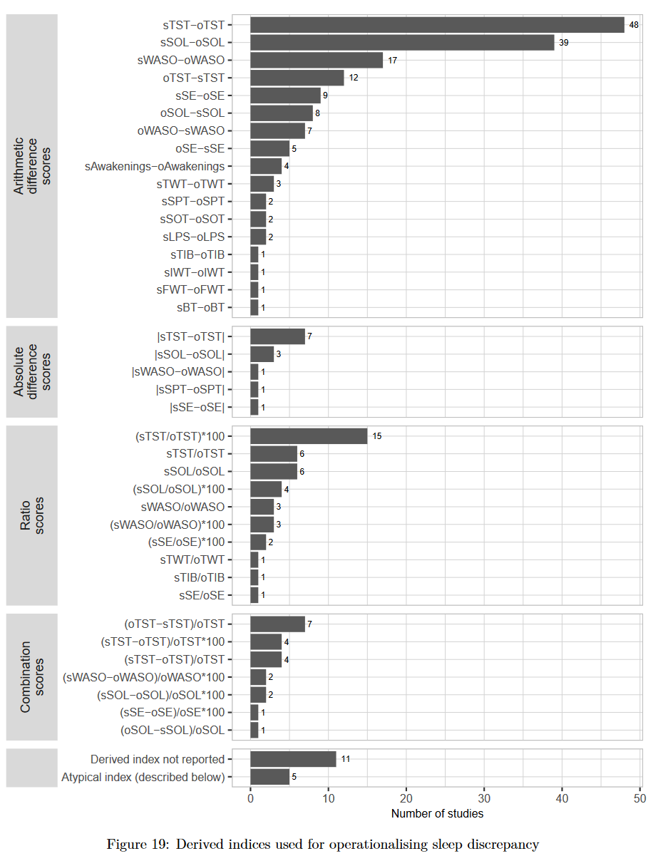


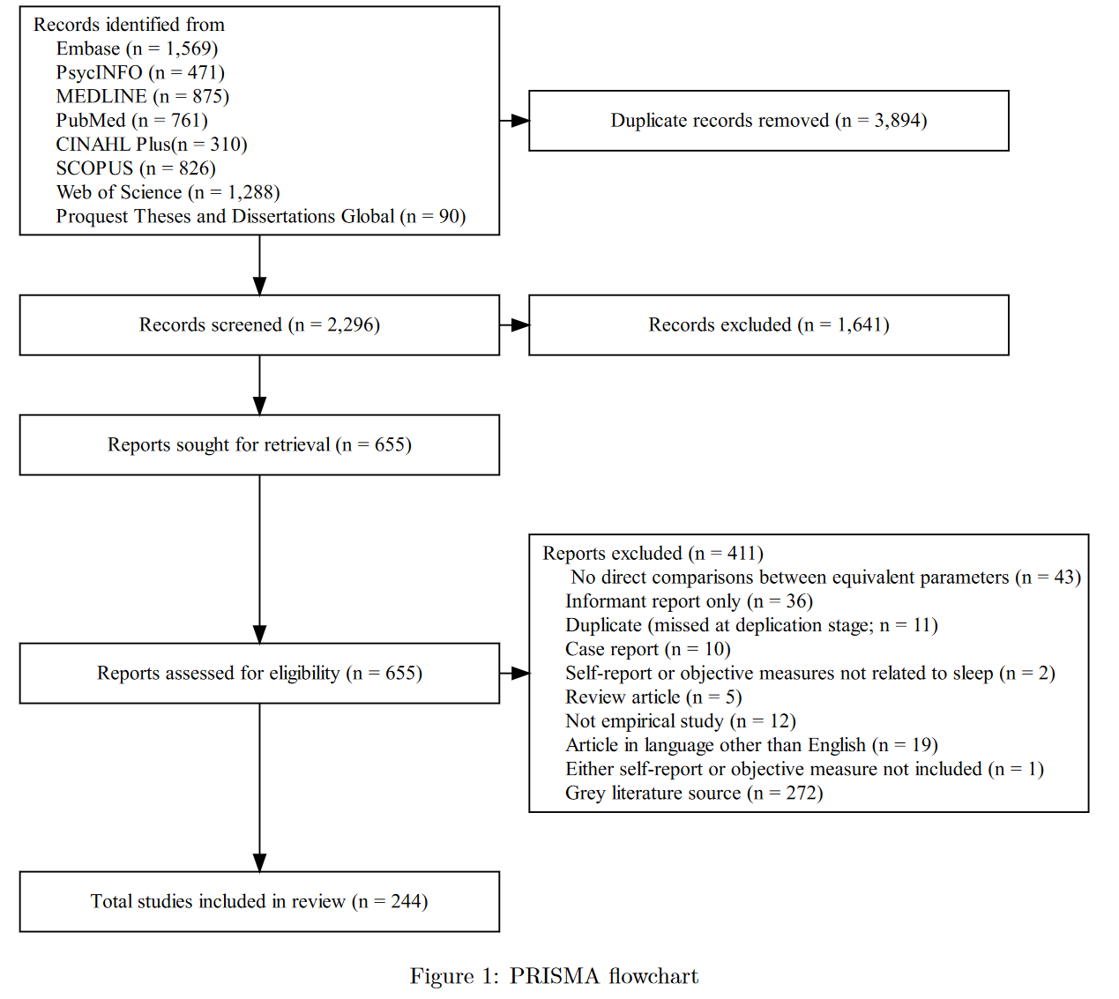
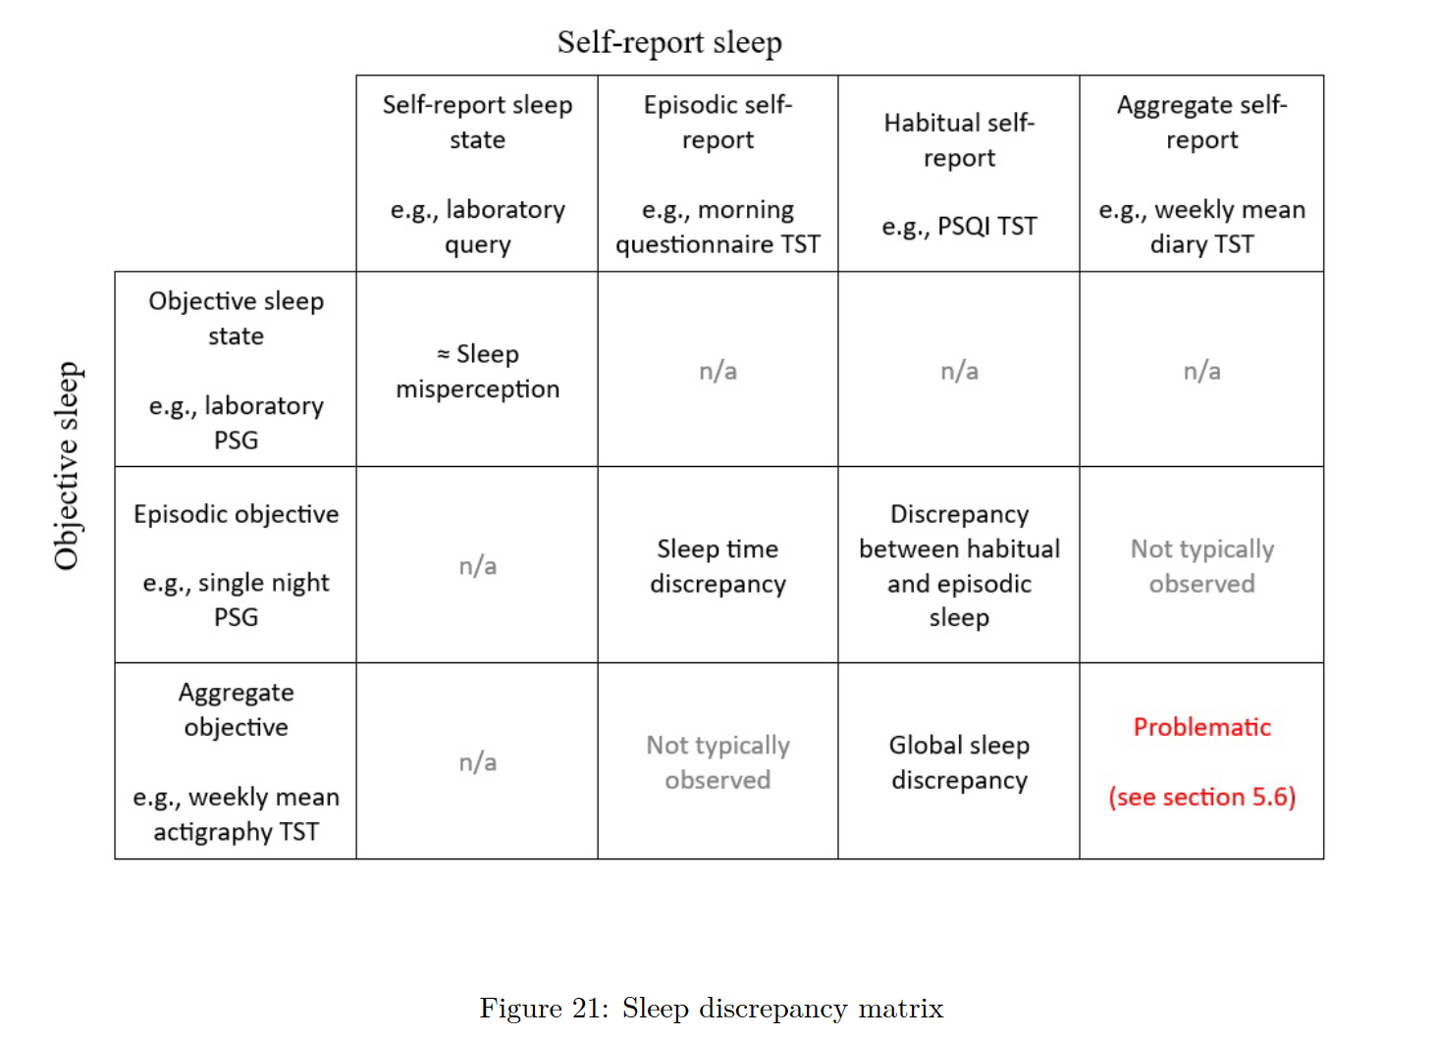
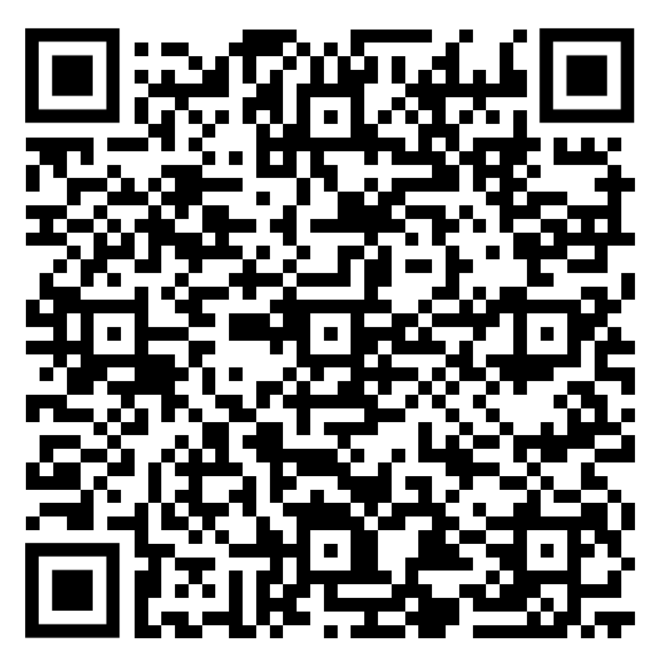
A scoping review of sleep discrepancy methodology:
what are we measuring and what does it mean?
Results
There are different types of sleep discrepancy and significant problems with how they have been investigated.
Tom F. Walton ¹
tom.fioccowalton@research.uwa.edu.au https://github.com/tfwalton
Melissa J. Ree¹ Simone N. Fueggle² Romola S. Bucks^{1,3,4}
¹ School of Psychological Science, The University of Western Australia ² CALHN Neuropsychology, Royal Adelaide Hospital ³ School of Population and Global Health, The University of Western Australia ⁴ Office of the Deputy Vice Chancellor, Research, The University of Western Australia
Introduction
Sleep discrepancy is a common feature of insomnia disorder
Sleep discrepancy has been investigated with diverse methods making it difficult to integrate findings across studies
AIM: How has sleep discrepancy has been conceptualised in the literature what methods have been used to investigate it?
Approximately half (n = 128) of included studies calculated a derived index (e.g., self-report TST–objective TST) to operationalise sleep discrepancy
172 studies measured sleep discrepancy at the group level by directly comparing self-report and objective sleep
Method
Conclusions
Sleep discrepancy is mostly restricted to sleep states or sleep time and varies in its conceptual distance to sleep misperception
Scoping review methodology
Included: all comparing self-report with objective measure of sleep
Conceptual and methodological problems
Methodological heterogeneity
Objective SOL definitions
Operationalising with derived indices
Averaging across nights
Correlations as concordance
Sleep quality discrepancy
Sleep diaries defining rest intervals
SCAN ME

Slide 2

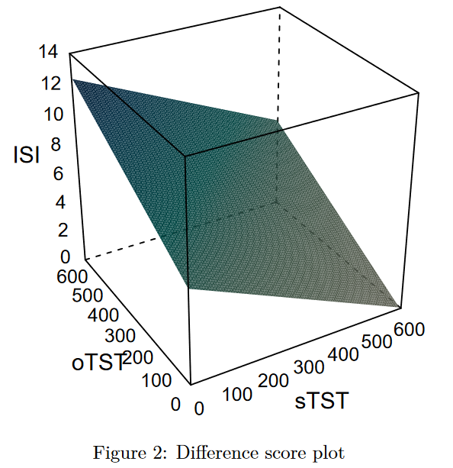
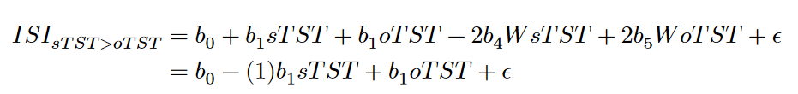
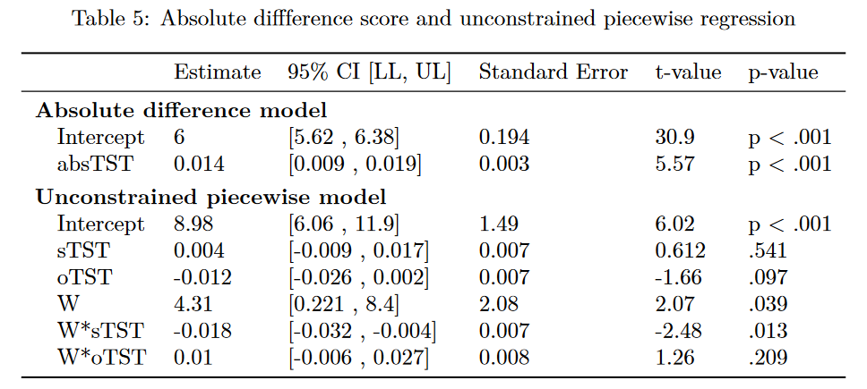
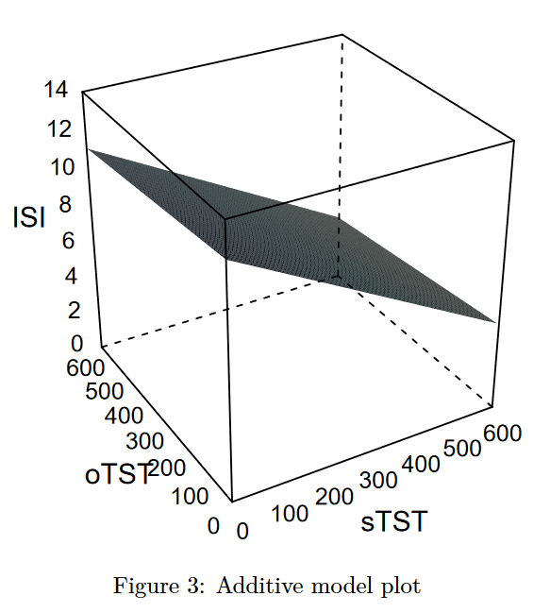
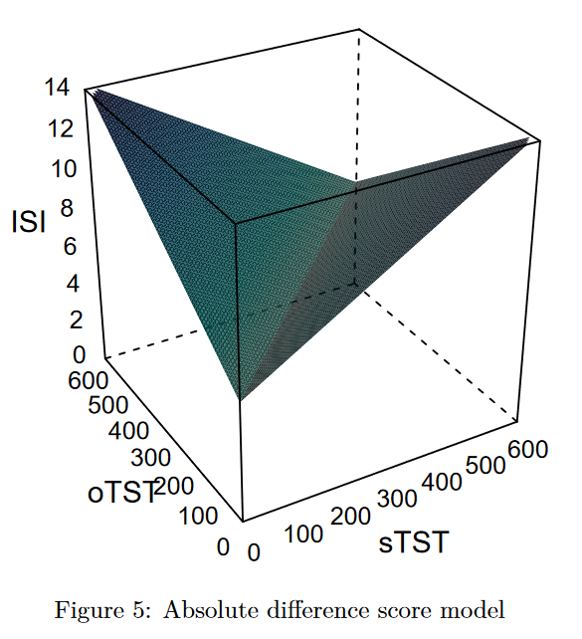
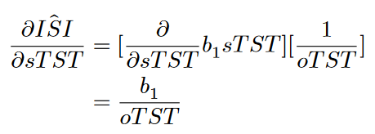
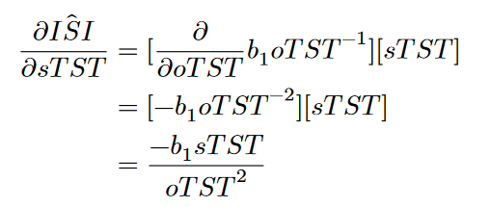
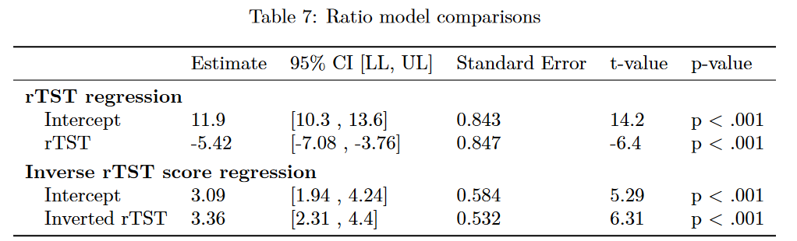
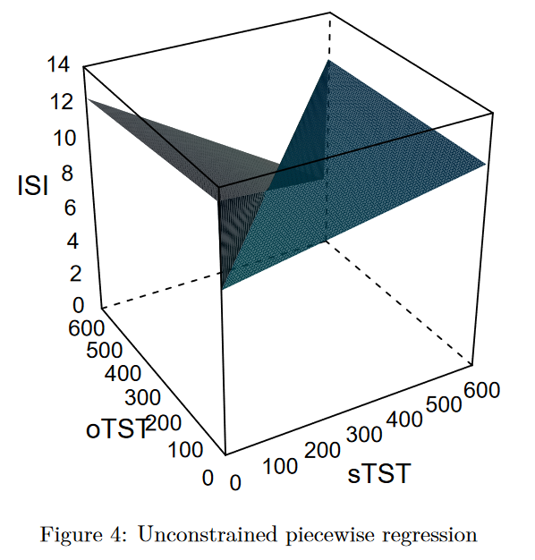
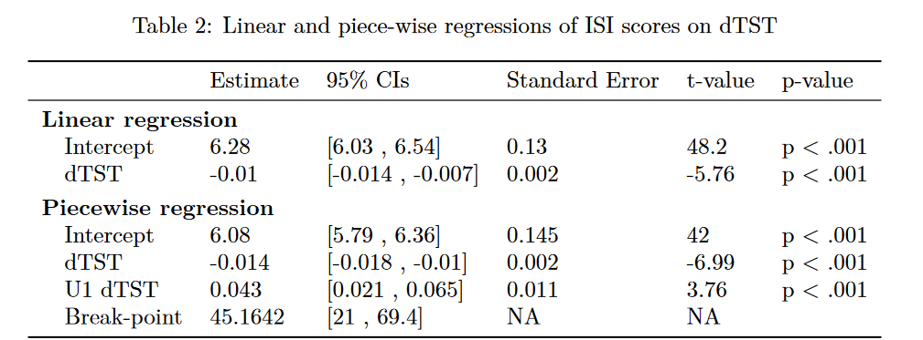
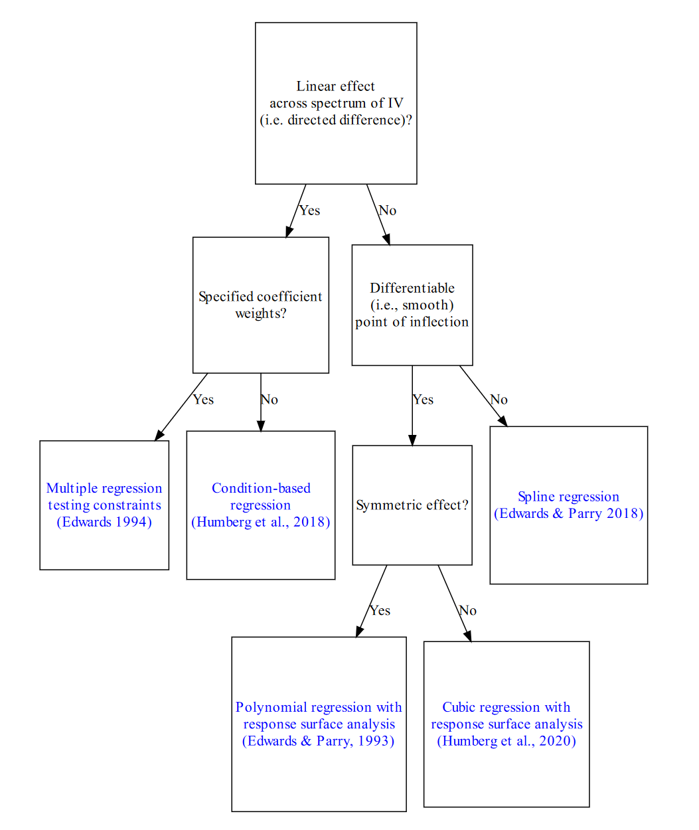
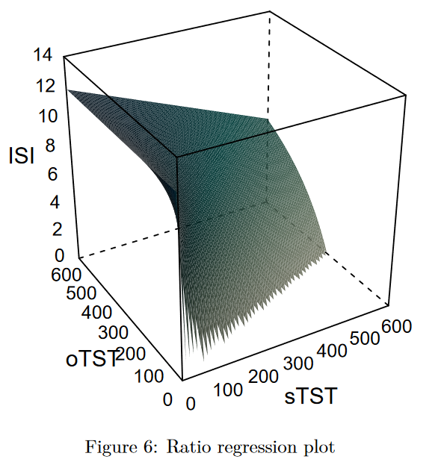

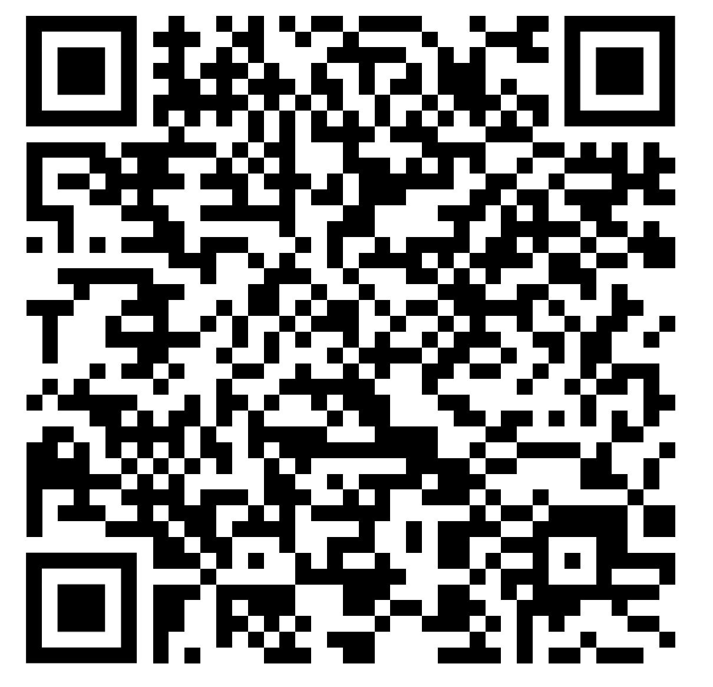
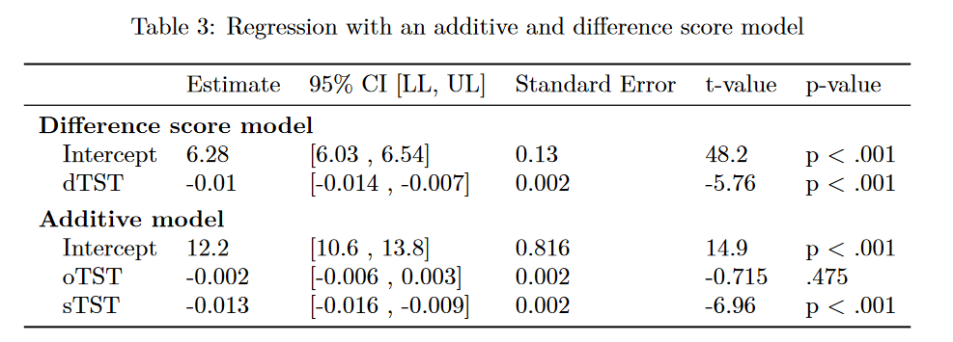
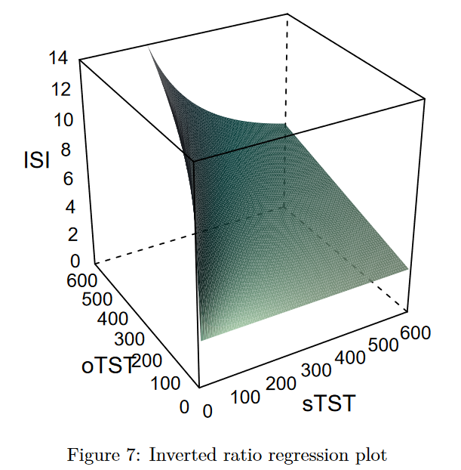
On the use of difference and ratio scores in sleep discrepancy research
Absolute difference score problems
There are significant problems with the use of difference and ratio scores in sleep discrepancy research.
Directionality full-range symmetrical distribution may not be present
Implicit constraints components equal in magnitude opposite in sign, pattern reverses at X = Y, no combined main effect of predictors
Tom F. Walton ¹
tom.fioccowalton@research.uwa.edu.au https://github.com/tfwalton
Melissa J. Ree¹ Romola S. Bucks^{1,2,3}
¹ School of Psychological Science, The University of Western Australia ² School of Population and Global Health, The University of Western Australia ³ Office of the Deputy Vice Chancellor, Research, The University of Western Australia
Introduction
Sleep discrepancy is the discordance between self-report and objective measures of sleep
Sleep discrepancy is often operationalised as a derived index (e.g., self-report TST – objective TST)
Derived indices are associated with a range of conceptual and methodological problems
The R² from the absolute difference score model (R² = 0.03) was reduced more than two-fold from the unconstrained piecewise regression (R² = 0.072) a difference that was statistically significant (F =11.2, p < .001).
Ratio score problems
Directionality identified effects exist through the full range of a difference score
Arbitrary designation of numerator/ denominator
Method
Archival data: Healthy Ageing Research Programme (N = 230; age 50+)
Objective sleep using actigraphy with concurrent sleep diaries
Questionnaires measures including the insomnia severity index.
Difference score problems
Directionality identified effects exist through the full range of a difference score
Implicit constraints opposite in sign and dependent on value of the other component
Solutions
Muggeo’s score test for one or two changes in the slope of regression (Muggeo 2016) is statistically significant, observed value = 2.026, p = 0.043
Implicit constraints components equal magnitude opposite in sign
SCAN ME
A statistically significant reduction in R² from the additive (R² = 0.059) to the difference score model (R² = 0.023) is observed (F =53.7, p < .001)

Slide 3
On the use of difference and ratio scores in sleep discrepancy research
Ratio score problems
There are significant problems with the use of difference and ratio scores in sleep discrepancy research.
Directionality identified effects exist through the full range of a difference score
Arbitrary designation of numerator/ denominator
Tom F. Walton ¹
tom.fioccowalton@research.uwa.edu.au https://github.com/tfwalton
Melissa J. Ree¹ Romola S. Bucks^{1,2,3}
¹ School of Psychological Science, The University of Western Australia ² School of Population and Global Health, The University of Western Australia ³ Office of the Deputy Vice Chancellor, Research, The University of Western Australia
Absolute difference score problems
Implicit constraints opposite in sign and dependent on value of the other component
Introduction
Directionality full-range symmetrical distribution may not be present
Implicit constraints components equal in magnitude opposite in sign, pattern reverses at X = Y, no combined main effect of predictors
Sleep discrepancy is the discordance between self-report and objective measures of sleep
Sleep discrepancy is often operationalised as a derived index (e.g., self-report TST – objective TST)
Derived indices are associated with a range of conceptual and methodological problems
Method
Archival data: Healthy Ageing Research Programme (N = 230; age 50+)
Objective sleep using actigraphy with concurrent sleep diaries
Questionnaires measures including the insomnia severity index.
Difference score problems
Directionality identified effects exist through the full range of a difference score
Solutions
The R² from the absolute difference score model (R² = 0.03) was reduced more than two-fold from the unconstrained piecewise regression (R² = 0.072) a difference that was statistically significant (F =11.2, p < .001).
Muggeo’s score test for one or two changes in the slope of regression (Muggeo 2016) is statistically significant, observed value = 2.026, p = 0.043
Implicit constraints components equal magnitude opposite in sign
A statistically significant reduction in R² from the additive (R² = 0.059) to the difference score model (R² = 0.023) is observed (F =53.7, p < .001)

Slide 4
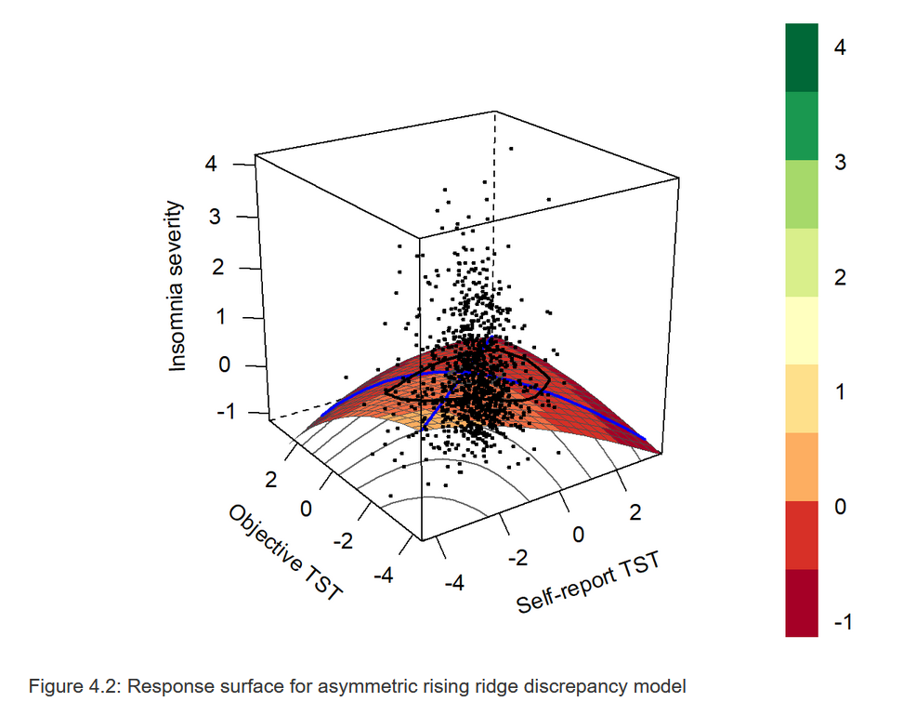
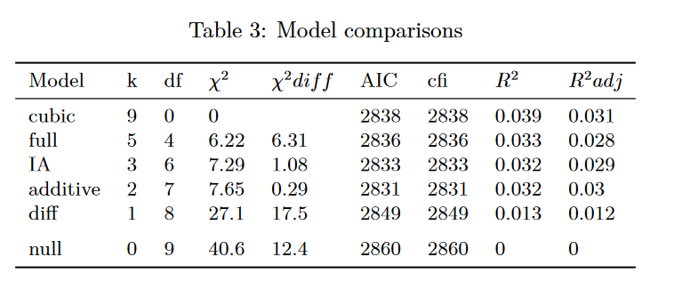
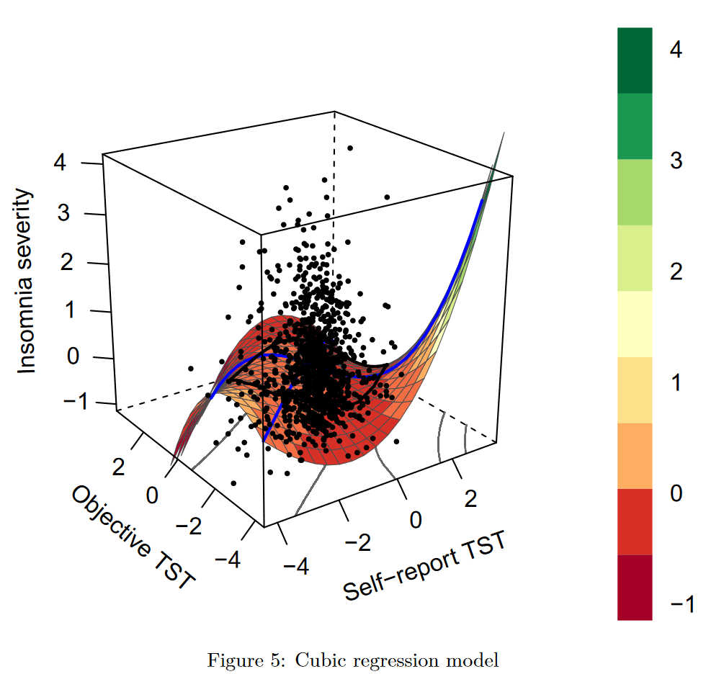
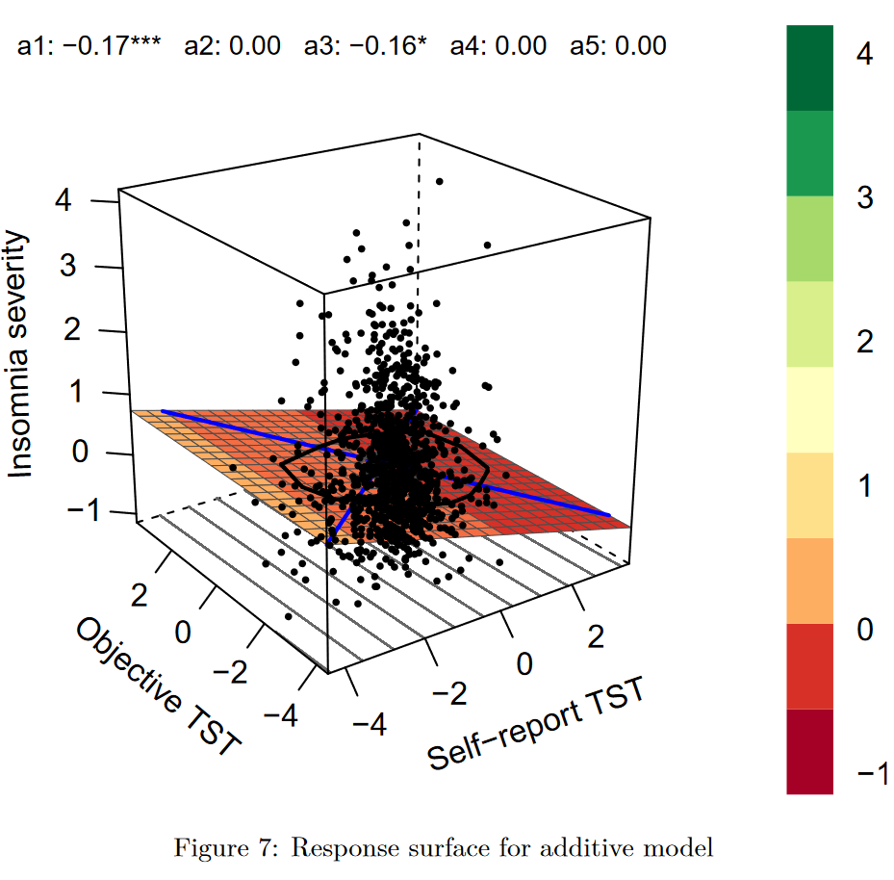
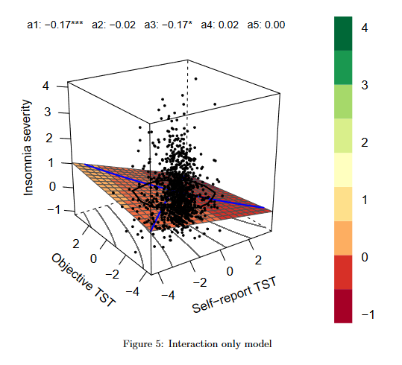
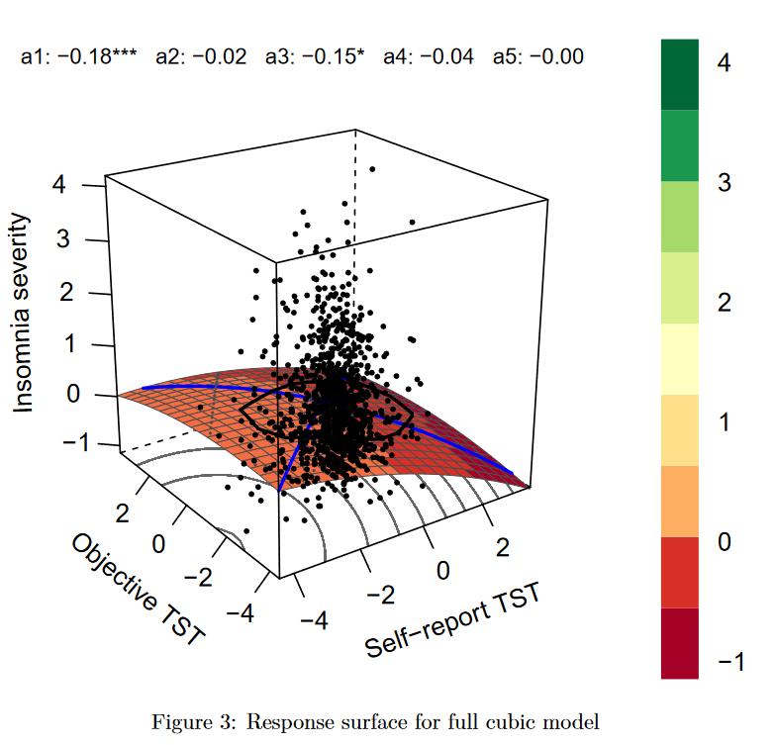
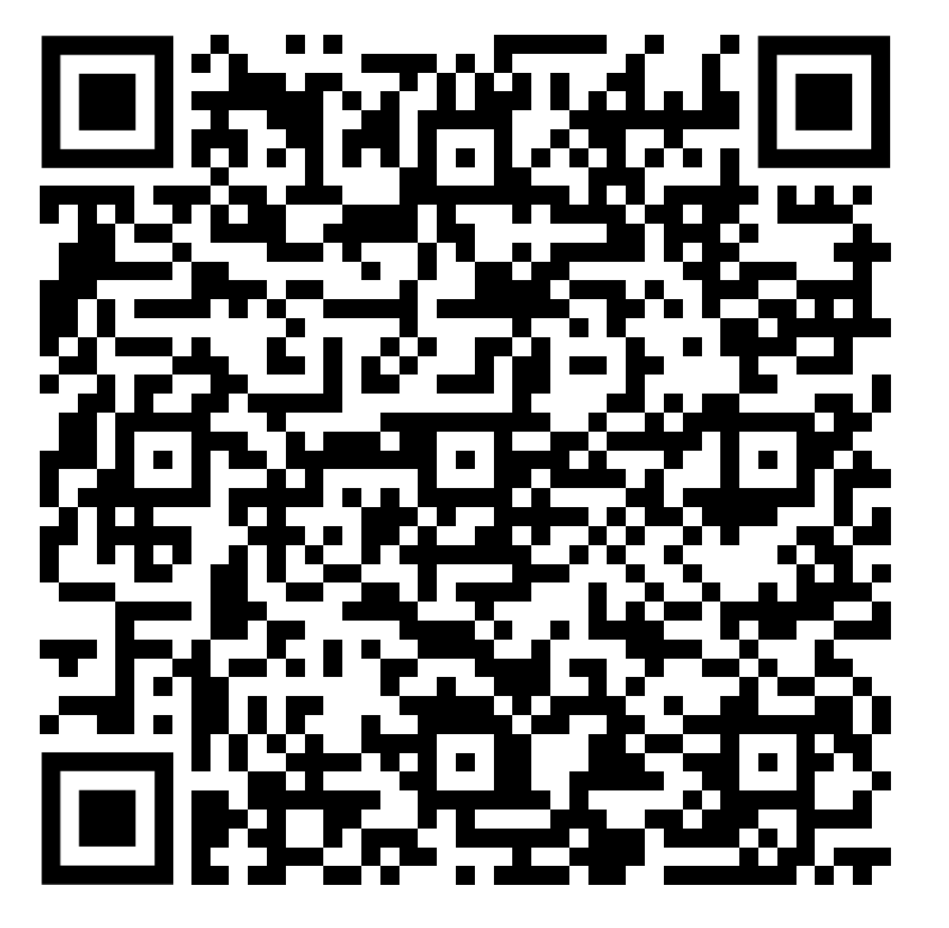
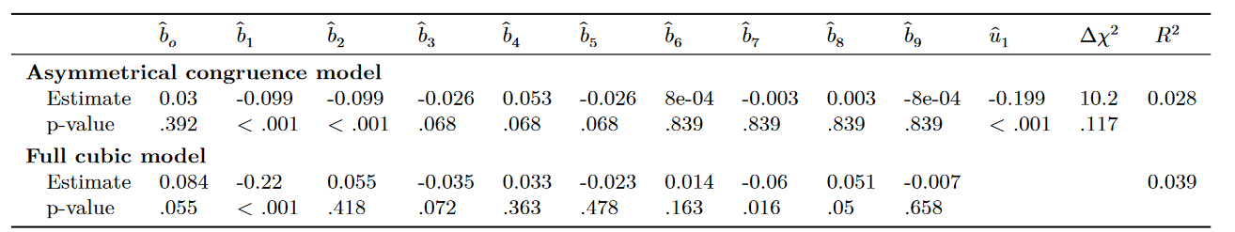
Insomnia and sleep discrepancy: an investigation with cubic response surface analysis pilot study
Response surface analysis revealed sleep discrepancy was not associated with insomnia symptom severity in older men.
Tom F. Walton ¹
tom.fioccowalton@research.uwa.edu.au https://github.com/tfwalton
Romola S. Bucks^{1,2,3} Melissa J. Ree¹
¹ School of Psychological Science, The University of Western Australia ² School of Population and Global Health, The University of Western Australia ³ Office of the Deputy Vice Chancellor, Research, The University of Western Australia
Introduction
Sleep discrepancy is often operationalised as a derived index (e.g., self-report TST – objective TST)
Cubic regression with response surface analysis solves many problems associated with the use of difference and ratio scores in operationalising sleep discrepancy
Hypothesis:
Discrepancy effect (H1.1)
Discrepancy effect is asymmetric in the expected direction (H1.2)
Linear level effect (H1.3)
Method
Data from MrOS 1,022 community-dwelling men aged 65+ years.
Total sleep time (TST) from single-night polysomnography (PSG)
Self reported TST from morning questionnaire
Insomnia severity index (ISI) to measure insomnia symptom severity
Rising ridge congruence surface b₁ = b₂, b₄ = −2 ∗ b₃, b₅ = b₃, b₇ = −3 ∗ b₆,
b₈ = 3 ∗ b₆, b₉ = −b₆
b₃ discrepancy effect (H1.1) must be significantly positive
b₆ direction & presence of asymmetry (H1.2) must be significantly negative
u₁ (b₁ + b₂) linear level effect (H1.3) must be significantly negative
Conclusions
Results
Response surface analysis is a useful alternative to derived indices for investigating sleep discrepancy
Discrepancy in sleep time parameters can be importantly different to misperception
Emphasis on perception of sleep quantity rather than sleep misperception per se
Experiments with hypnotics
Low self-report + objective as different phenotype
Results to be replicated in pre-registered study
Table 1. Parameters for rising ridge asymmetric congruence model
SCAN ME

